Slide 1
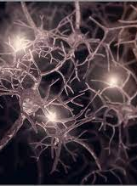
Lifespan Psychology: Plasticity
AEPSY Year 11 ATAR

Slide 2
Review
Draw a labelled neuron.
Is the neuron you have drawn a motor, inter- or sensory neuron?
What is the alternative name for each of the above neurons?
Which types of neurons are in the PNS and CNS and what are their individual functions?
What is the function of the myelin sheath?

Slide 3
Review
6. What are the 3 R’s of animal ethics?
7. Explain stratified sampling technique?
8. For an experimental study, explain the difference between a controlled variable and a control group?

Slide 4
Learning Intentions
role of brain plasticity in infancy and adolescent development
adaptive and developmental plasticity
infancy
stages of plasticity – proliferation, migration, circuit formation, synaptic pruning, myelination

Slide 5
Success Criteria
Define neuroplasticity
Distinguish between developmental and adaptive neuroplasticity, giving examples.
Come up with an acronym for stages of plasticity during infancy
Define and draw a diagram to represent each stage

Slide 6
Brain plasticity
‘plastic’ = mouldable
Brain plasticity is the ability of neural connections to grow and reorganise.

Slide 7
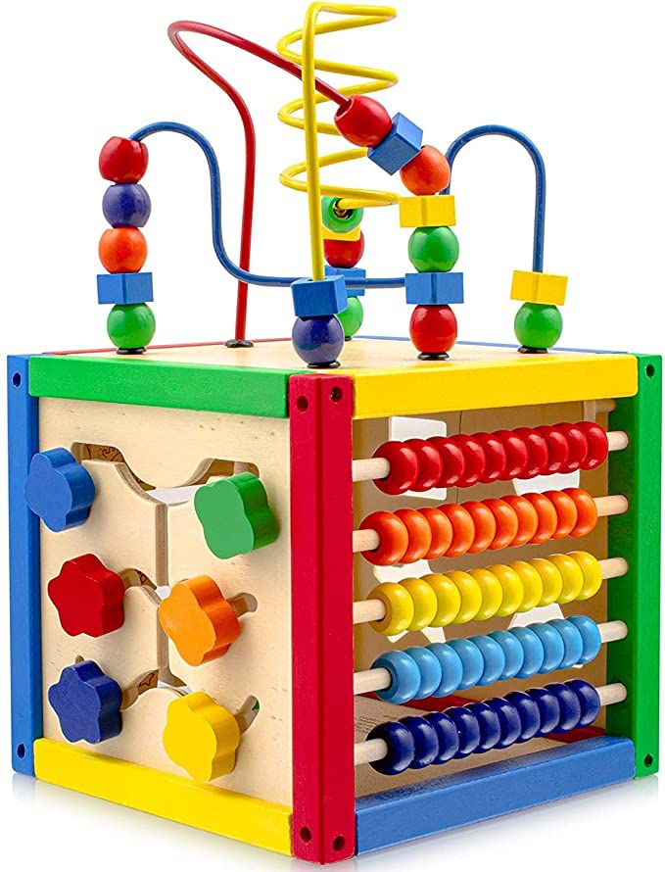
Developmental plasticity
The ability of neural connections in the brain to reorganise in response to sensory input from the environment, eg a baby playing with toys will practice fine motor skills, and reorganising brain functionality.

Slide 8
Adaptive plasticity
The ability of neural connections in the brain to reorganise in response to learning new information or to compensate for lost functions and take advantage of remaining functions.

Slide 9


Slide 10
Stages of plasticity during infancy
Proliferation
Migration
Circuit formation
Synaptic pruning
Myelination

Slide 11
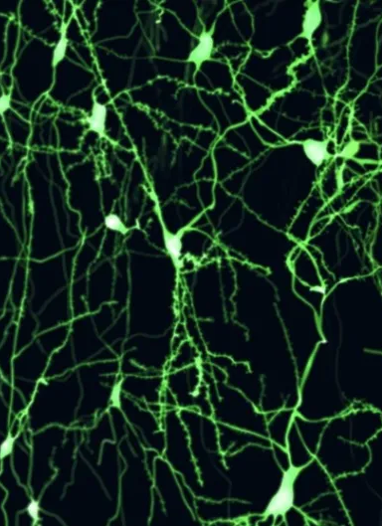
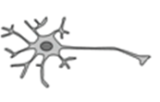
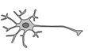
Proliferation
Growth and division of cells (increasing number of neurons)
While most neurons are already formed at birth, some new neurons are created during infancy.

Slide 12
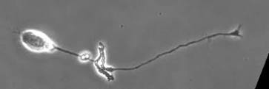
Migration
Newly generated neurons move throughout the infant brain, positioning themselves to allow for neural connections (neural circuits) to be made.
Ends about age 5 months

Slide 13
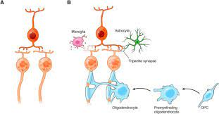
Circuit formation
After migration, neurons form circuits with connections between clusters of neurons or over larger distances. During infancy, neural circuits develop rapidly, especially in the primary sensory and primary visual cortex.

Slide 14
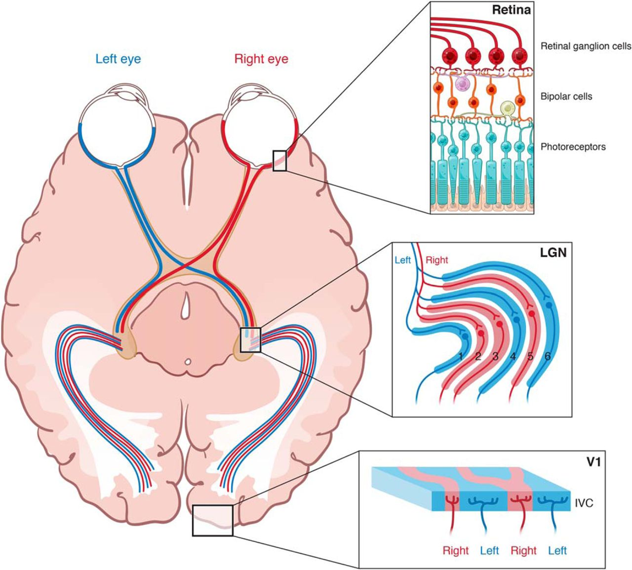

Slide 15
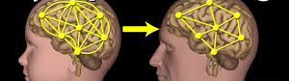
Synaptic Pruning
Infants are born with more neurons than required. Any neurons that do not form active neural connections with other neurons die. This increases the efficiency by strengthening remaining connections and allowing them to grow in complexity.

Slide 16
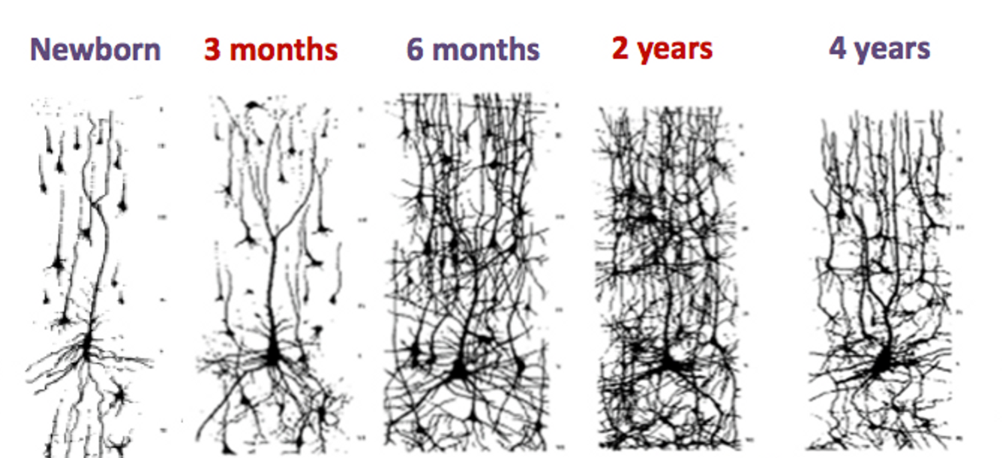

Slide 17
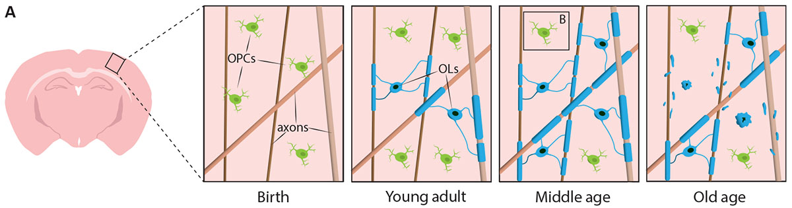
Myelination
Myelination, allowing faster and more efficient nerve impulses, contributes to dramatic brain growth in infants.
Myelination begins in the spinal cord, then hindbrain, midbrain, forebrain then finally peripheral nervous system.

Slide 18
Success Criteria
Define neuroplasticity
Distinguish between developmental and adaptive neuroplasticity, giving examples.
Come up with an acronym for stages of plasticity during infancy
Define and draw a diagram to represent each stage

